Slide 1
Guide to Modify and Compile ESPResSo
Sarah Ameur, August 2024, McGill University

Slide 2
Overview
Objective: Modify the molecular dynamics software ESPResSo to include a custom Shape object named Channel.
ESPResSo GitHub repository: https://github.com/espressomd/espresso
ESPResSo release 4.2.2: https://github.com/espressomd/espresso/releases

Slide 3
Overview (cont’d)
Tasks:
Write additional C++ scripts:
espresso-4.2.2\src\shapes\include\shapes\Channel.hpp
espresso-4.2.2\src\shapes\src\Channel.cpp
espresso-4.2.2\src\script_interface\shapes\initialize.cpp
espresso-4.2.2\src\script_interface\shapes\interface_Channel.hpp
espresso-4.2.2\src\shapes\src\src_shapes_src_Channel.cpp
espresso-4.2.2\src\shapes\unit_tests\Channel_test.cpp
Modify existing files:
espresso-4.2.2\espresso-4.2.2\src\shapes\CMakeLists.txt
espresso-4.2.2\espresso-4.2.2\src\script_interface\CMakeLists.txt
espresso-4.2.2\src\python\espressomd\shapes.py
espresso-4.2.2\src\python\espressomd\visualization.py
espresso-4.2.2\src\python\espressomd\CMakeLists.txt
Install dependencies
Compile the modified software

Slide 4
Initial Setup
Example:
cd ~
mkdir espresso
cd espresso
git clone https://github.com/espressomd/espresso.git .
cp ~/Channel.cpp ~/espresso/src/shapes/src/Channel.cpp
...

Slide 5
Dependencies Installation
GIVE INSTRUCTIONS (export PATH_VARS, examples of error messages, ..) ABOUT EACH:
islpy
anaconda
chocolatey
Set-ExecutionPolicy Bypass -Scope Process -Force; [System.Net.ServicePointManager]::SecurityProtocol = [System.Net.ServicePointManager]::SecurityProtocol -bor 3072; iex ((New-Object System.Net.WebClient).DownloadString('https://community.chocolatey.org/install.ps1'))
fftw
downloaded package from: https://www.fftw.org/install/windows.html
both 32-bit version: fftw-3.3.5-dll32.zip (2.6MB)
& 64-bit version: fftw-3.3.5-dll64.zip (3.1MB)
extracted both packages to "C:/fftw-3.3.5-dll32" and "C:/fftw-3.3.5-dll64"
export FFTW3_LIBRARIES=/c/fftw-3.3.5-dll64/libfftw3-3.dll
export FFTW3F_LIBRARIES=/c/fftw-3.3.5-dll32/libfftw3f-3.dll
export FFTW3_INCLUDE_DIR=/c/fftw-3.3.5-dll64/include
export PATH=/c/fftw-3.3.5-dll64:$PATH

Slide 6
Dependencies Installation (cont’d)
g++ command:
minGW-w64 installer: https://sourceforge.net/projects/mingw/
add mingw to $PATH: Windows > Environment variables > New variable > Path > add "C:\MinGW\bin“
ninja:
..
mpi:
Installed it at:
msmpisdk.msi: first part of the package: C:\Program Files (x86)\Microsoft SDKs\MPI\
...: second part of the package: "C:\Program Files\Microsoft MPI\"
export PATH="/c/Program Files/Microsoft MPI/Bin:$PATH"
export MPI_INCLUDE_PATH="/c/Program Files/Microsoft MPI/Include"
export MPI_LIB_PATH="/c/Program Files/Microsoft MPI/Lib/x64"
boost
cuda

Slide 7
Compilation
cd ~/espresso
rm -r env build
python -m venv env
source env/Scripts/activate
python -m pip install -c requirements.txt cython numpy scipy matplotlib
mkdir build
cd build
rm CMakeCache.txt
rm -r CMakeFiles

Slide 8
Compilation (cont’d)
cmake -DFFTW3_LIBRARIES=/c/fftw-3.3.5-dll64/libfftw3-3.dll \
-DFFTW3F_LIBRARIES=/c/fftw-3.3.5-dll32/libfftw3f-3.dll \
-DFFTW3_INCLUDE_DIR=/c/fftw-3.3.5-dll64/include \
-DMPI_C_INCLUDE_DIRS="C:/Program Files (x86)/Microsoft SDKs/MPI/Include" \
-DMPI_C_LIBRARIES="C:/Program Files (x86)/Microsoft SDKs/MPI/Lib/x64/msmpi.lib" \
-DMPI_CXX_INCLUDE_DIRS="C:/Program Files (x86)/Microsoft/SDKs/MPI/Include" \
-DMPI_CXX_LIBRARIES="C:/Program Files (x86)/Microsoft/SDKs/MPI/Lib/x64/msmpi.lib" \
-DMPIEXEC_EXECUTABLE="C:/Program Files/Microsoft MPI/Bin/mpiexec.exe" \
-DMPI_VERSION=3.0 \
-DMPI_C_VERSION=3.0 \
-DMPI_CXX_VERSION=3.0 \
-DCMAKE_VERBOSE_MAKEFILE:BOOL=ON \
..

Slide 9
Running a Simulation script
Example:
~/channel.py

Slide 10
Future Steps
write and integrate file:
espresso-4.2.2\src\script_interface\shapes\initialize.cpp
modify and integrate files:
espresso-4.2.2\src\shapes\CMakeLists.txt
espresso-4.2.2\src\script_interface\CMakeLists.txt
finish installing dependencies by running cmake and looking at the error messages
run the simulation script channel.py

Slide 11
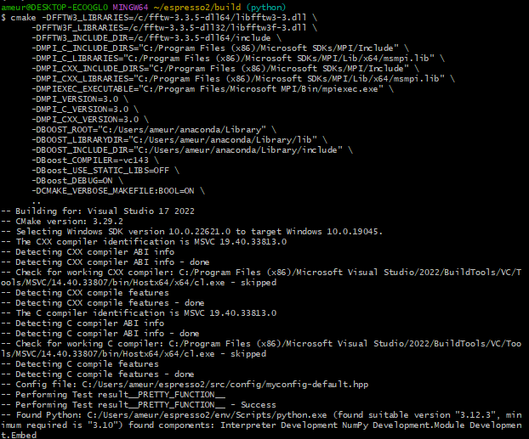
Future Steps
current state:

Slide 12
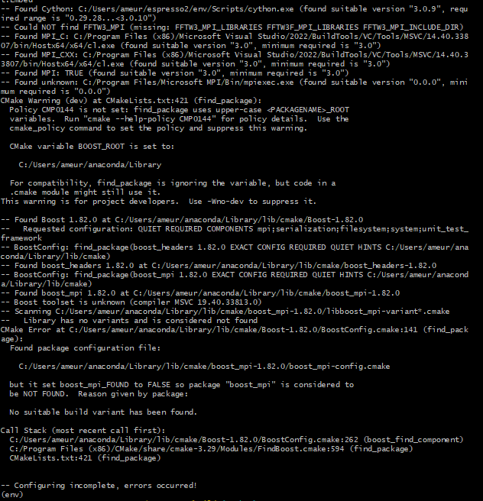
Future Steps
current state:

